Slide 1
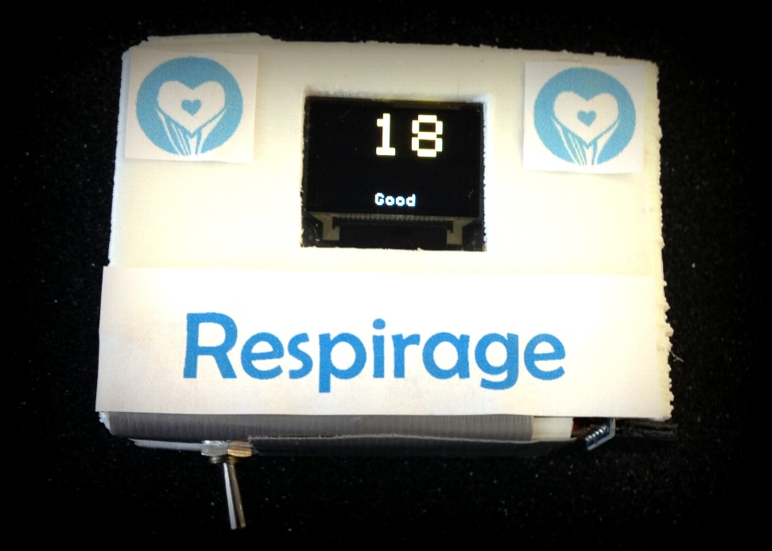

Design Team 7
Respiratory Rate Measurement Device
for Emergency Department Triage
Richard Chen, Phani Gaddipati,
Shohini Ghosh, Alexia Haralambous, Bryan Kuo,
Katrina Lee, Alex Mullen, Corby Rosset
Clinical Advisors: Dr. Edbert Hsu & Dr. Samuel Yang

Slide 2
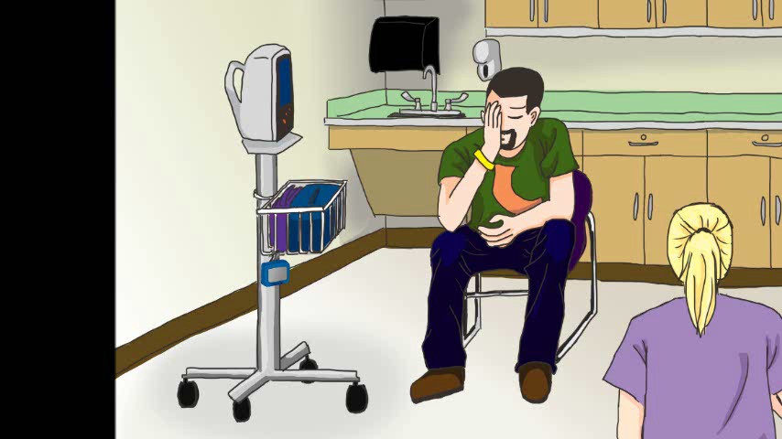
Clinical Problem
Problem
Need
Design
Prototype
Testing
Future
pulse rate | O₂ saturation | respiratory rate (RR) | blood pressure | temperature
Notes:
- Every year, 129.8 mill patients visit ED.
Define triage – purpose, how is it done (thru vitals assessment),
Mention how vitals are measured in triage to determine severity of patient’s condition
we are focusing on respiratory rate
“First, you go through a fast-paced process called triage, where a nurse will take your 5 vitals, respiratory rate, pulse rate, O2 saturation, blood pressure, and temperature and ask you questions. Vitals are taken to determine the severity of the patient, and this process determines how quickly you’ll receive the appropriate care. As you might have noticed, respiratory rate was not measured by the nurse in this clip.
- By the end of this presentation, approximately 7000 patients will have visited the ED.
Disease states that cause changes in metabolic processes (too much CO2 = acidic, etc) are often manifested in change of the respiratory rate. Respiratory rate is clear indicator of acidotic states, as the main function of respiration is removal of CO₂ leaving bicarbonate base in circulation

Slide 3
Clinical Problem
Problem
Need
Design
Prototype
Testing
Future
RR can predict…
Tachypnic Conditions
Cardiac Arrest
Congestive Heart Failure
Chronic Obstructive Pulmonary Disease
Metabolic/Respiratory Acidosis
Sepsis/Systemic Inflammation
Various Respiratory Diseases
Bradypnic Conditions
Cardiogenic Shock
Myocardial Infarction
Hypertension
Diabetic Ketoacidosis
Rheumatic Fever
Hypoxia
RR is a sensitive predictor of diverse illnesses
… and is the best predictor of cardiac arrest (CA).
RR > 27 bpm can predict CA within 72 hours with 54% sensitivity & 83% specificity
Cardiac Arrest | Frequency | Mortality Rate
In-hospital: Out-of-hospital: | 209,000/year 359,400/year | 75.8% 90.5%
Notes:
Respiratory rate can predict several conditions., The normal range for RR: 12-20 BPM, so anything above 20 breaths is tachypnea, and anything below is bradynpea.
Most importantly, it is most effective in predicting the onset of cardiac arrest.
Approximately 2000 cardiac arrests occur each day.
If necessary:
Sensitivity (also called the true positive rate, or the recall rate in some fields) measures the proportion of actual positives which are correctly identified as such (e.g. the percentage of sick people who are correctly identified as having the condition). Specificity (sometimes called the true negative rate) measures the proportion of negatives which are correctly identified as such (e.g. the percentage of healthy people who are correctly identified as not having the condition).
RR has highest specificity and sensitivity of the 5 vitals

Slide 4
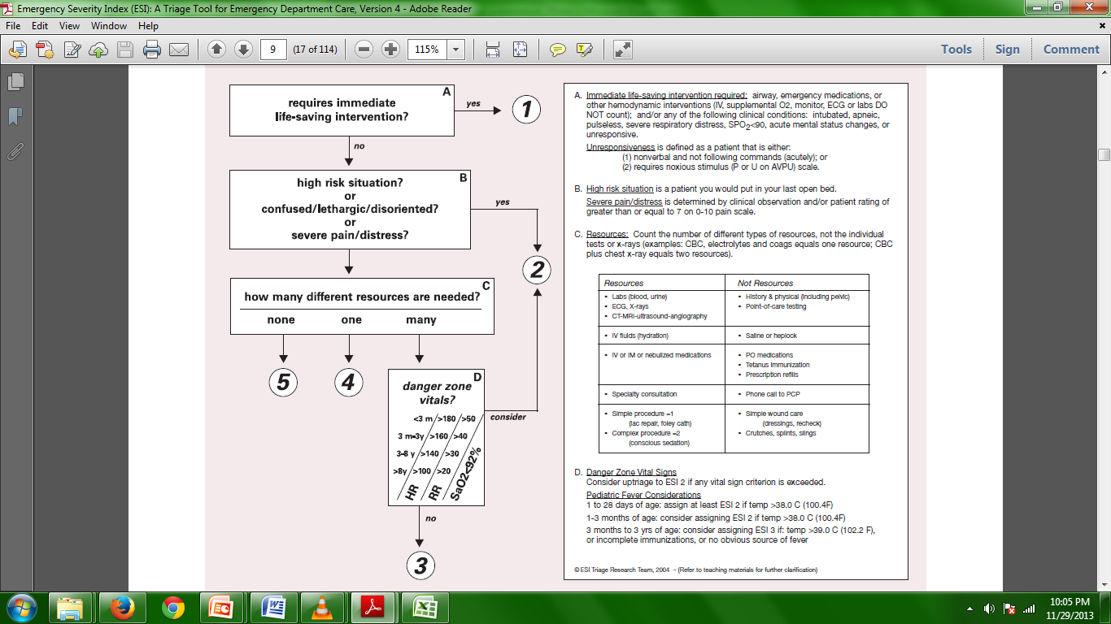
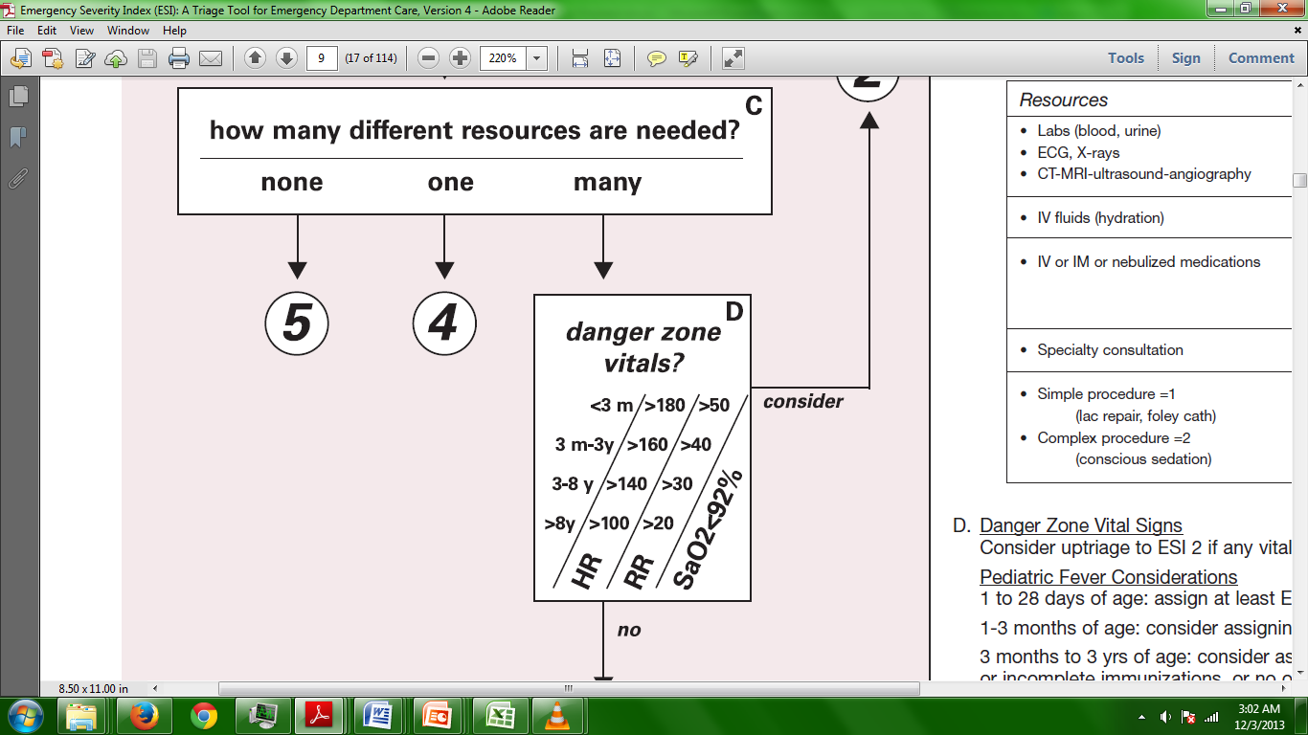
Clinical Problem
Problem
Need
Design
Prototype
Testing
Future
Immediate placement in hospital bed
Unspecified waiting time
Notes:
Most hospitals utilize a triage workflow similar to the chart depicted here. PROBLEM :Patient who need appropriate care are not receiving it, clinical decision gets made on this information
RR plays a big role in medical decision-making because it characterizes the severity of a patient’s case, where a 1 is most severe and 5 is the least severe. With an accurate respiratory rate, a patient could easily go from 3 (unspecified waiting time) → 2 (immediate placement in hospital bed).

Slide 5
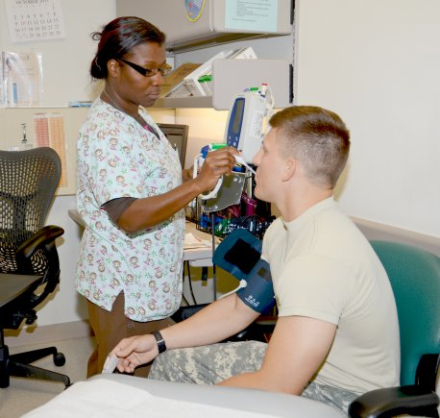
Standard of Care
Problem
Need
Design
Prototype
Testing
Future
Manual Measurement
Notes:
In the current standard of care, RR’s the only vital sign that’s measured manually in triage, while all other vital signs are measured electronically. Nurses would spend approximately 30 seconds of visual observation in measuring respiratory rate, three minutes measuring all the vitals, and seven minutes altogether in handling a patient in triage.
Unfortunately, manual measurement slows down triage workflow. This causes visual estimation from prior experience to occur, and as a result:
Unfortunately, because triage is such a fast pace process, and because they need to accommodate a large number of patients, nurses don’t have the time to this, as the guidelines causing visual estimation from prior experience to occurs. As a result,
The reason that there is visual estimation, is that nurses are so use to taking respiratory rate manually, that they feel like they can recognize what 16 breaths per minute looks like, when they really don’t.

Slide 6
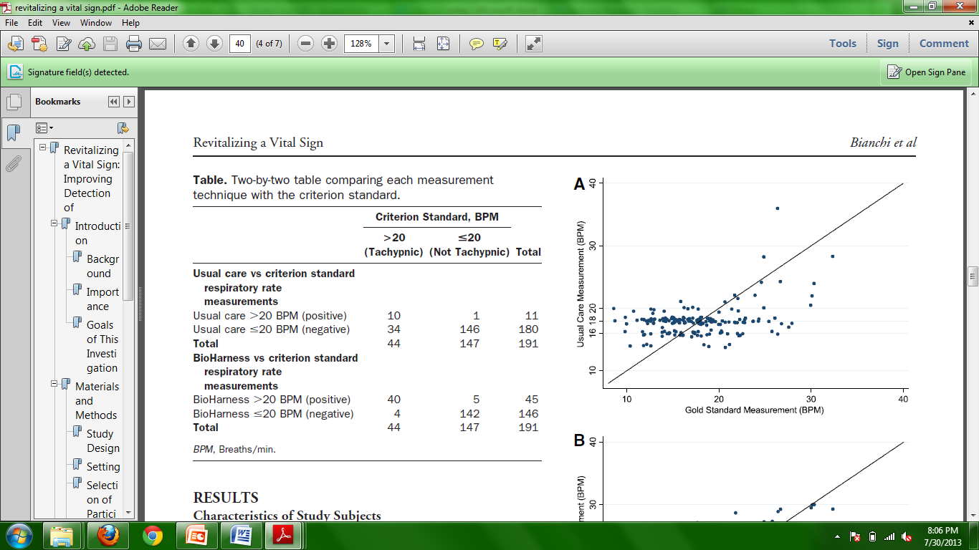
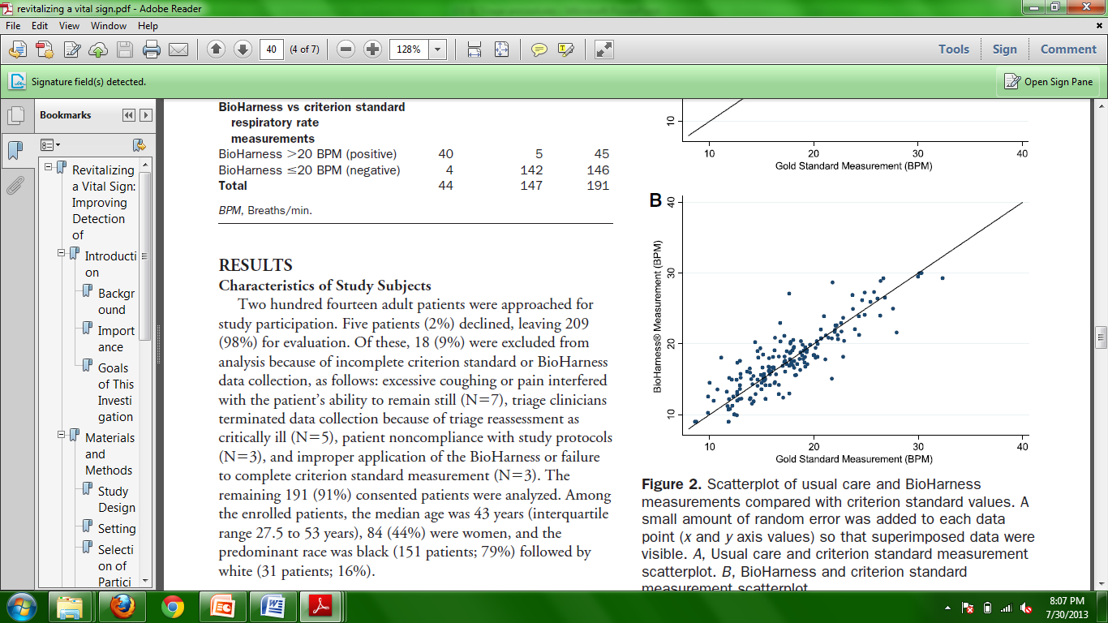

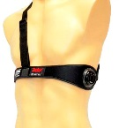
Problems with Standard of Care
Problem
Need
Design
Prototype
Testing
Future
RR is rarely measured accurately, if at all.
Measurements are clustered near 16 or 18 bpm, and inconsistent between different nurses.
Bianchi et. al.
Notes:
SOURCE
“interprovider variability”, inconsistent measurement between nurses
As a result, respiratory rate is rarely measured accurately, if at all.
In the graphs above is a Bland Altman Test, which is used to compare a new or existing measurement technique against a gold standard. In the first plot, the gold standard, which would be the actual respiratory rate, is measured against the respiratory rate recorded by the nurses. As you can see from the graph, nurse measurements cluster around 16 to 18 breaths per minute, which falls in the normal range. This test demonstrates that there is interprovider variability in the current standard of care, as nurses are inconsistently measuring respiratory rate. For example, this patient here, his/her actual respiratory rate was 30 BPM, but the respiratory rate recorded by the nurse was 16, placing that person in danger in not the appropriate care, as they could have a possible bradypnic condition. In the second plot, the actual respiratory rate is compared against existing technology, The BioHarness, which electronically measures RR. As you can see from the graph, the Bioharness measurements correlate very well with actual measurements, and does a much better job at predicting respiratory rate

Slide 7
After Speaking with Nurses…
Problem
Need
Design
Prototype
Testing
Future
“It’s not that important.”
RR is measured only when it “appears to be abnormal”
Other vitals require the “the press of one button”
“Disposability may be time-consuming”
Display of only real-time RR is necessary; “no need for an alerting system”
Notes:
After speaking with nurses… we realized that most nurses, and even some doctors, don’t realize the importance of RR. Because nurses feel that RR is not important, they tend to arbitrary pick values that fall in the normal range, as you saw earlier.l

Slide 8
Need
Problem
Need
Design
Prototype
Testing
Future
Goals
1. Measure RR in ≤ 15 sec.
2. Must be convenient & easily applied; must be user-friendly, simple, & intuitive¹⁹; ≥ 7/10 nurses must prefer our device over manual measurement.
3. Measure RR accurately with error ≤ ±2 bpm w.r.t. WHO gold standard.²
4. Provide visual feedback that displays real-time RR.
5. Minimize prototyping cost to ≤ $60 per device.
6. Minimize discomfort to patient; device does not cause pain.
7. Must be easy to be trained to use (proficiency after a 5-minute instructional video).
In order to detect the onset of certain illnesses earlier and to improve medical decision-making, there is a need to quickly and reliably measure respiratory rate in ED triage.
Notes:
To address the needs of nurses, doctors, and patients, we created a list of these goals:
- We plan on measuring RR under 15 seconds
- our device intuitive for nurses to use
The accuracy of our measurement device should be within a plus or minus two breaths per minute confidence interval
Some constraints we were given were that if our device ended up being contact-based, it had to be disposable, and the total time for our device to measure respiratory rate had to be under 180 seconds. The latter constraint is not a problem since we plan on doing it under 15 seconds.
Overall, in order to detect the onset of certain illnesses earlier and to improve medical decision making, our device needs to quickly and reliably measure respiratory rate in ED triage.

Slide 9
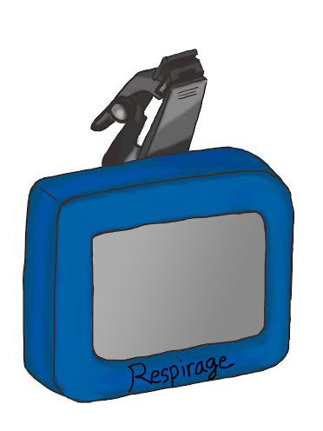
Our Solution
Problem
Need
Design
Prototype
Testing
Future
Clip for clothing attachment
LCD for RR display
Notes:
To solve the RR measurement problem, we made a simple, reusable device that can be quickly clipped to the patient’s clothing (Figure 1), and it measures RR with an accuracy of ±2 bpm. Respirage’s combination of speed, ease of use, and comfort, as well as its ultimate reduction of downstream healthcare costs makes it ideal for use by triage nurses in the ED.

Slide 10
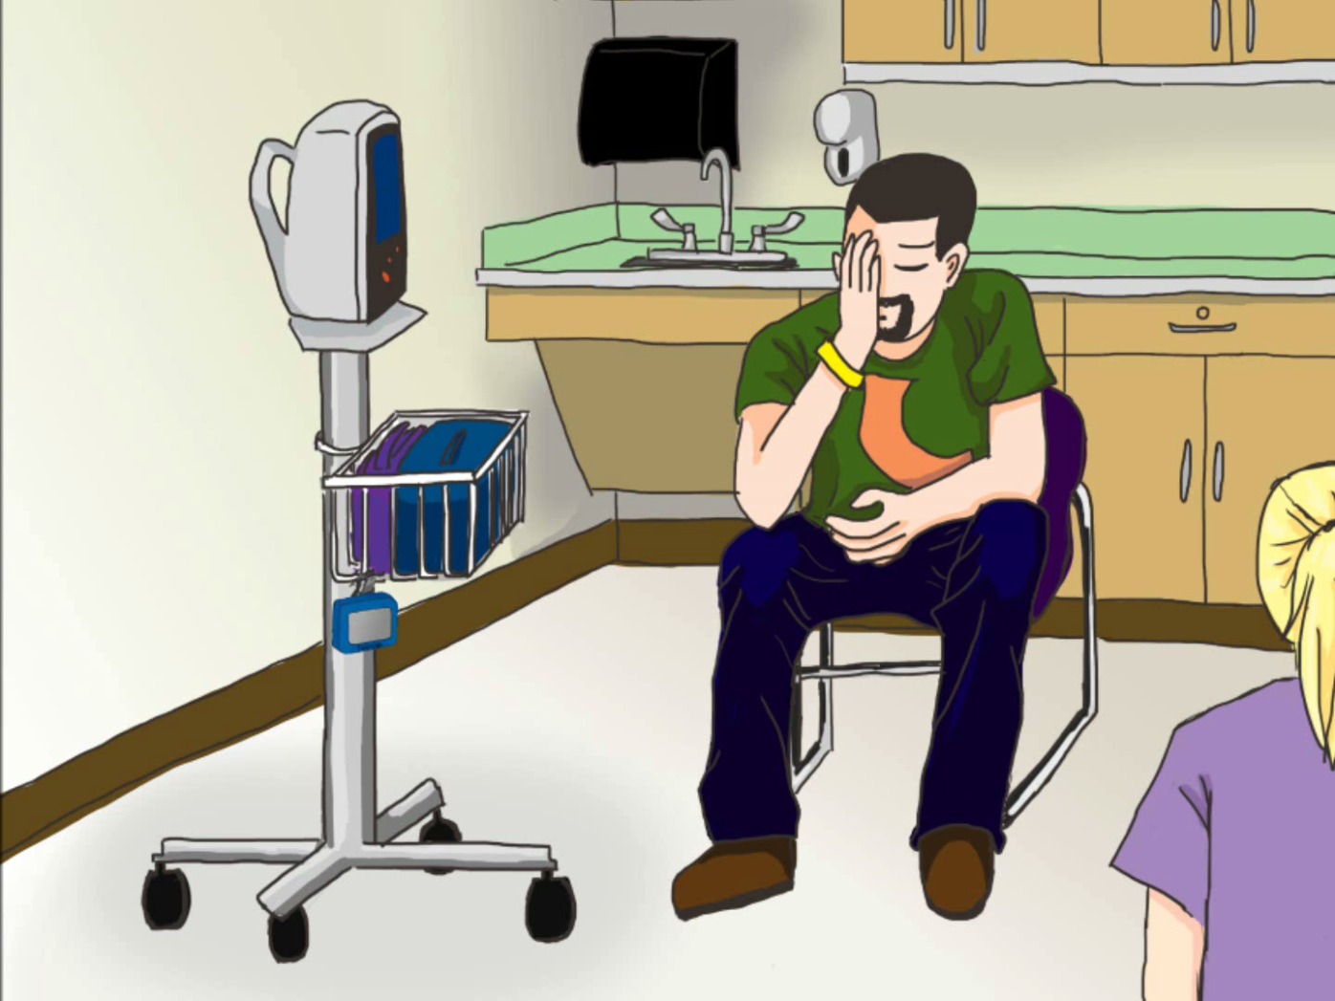
Device Implementation
Problem
Need
Design
Prototype
Testing
Future
Notes:
Describe step by step how the nurse takes vitals. Tell them to ignore the actual RR acquisition method here, just where the RR measurement comes into the workflow.
Make script fit video
Step 1: - Here is a typical patient who has a chief complaint in emergency triage
On the left is the dynamap, a multiparameter device that takes all vitals except for respiratory rate.
Step 2: Next, the nurse places the pulse oximeter onto the patient’s finger to measure pulse rate and oxygen saturation.
Step 3: Afterwards, the nurse places the blood pressure cuff onto the patient’s arm.
Step 4: Here, our measurement device, Respirage, is placed on the patient’s clothing near the upper stomach/lower chest to measure respiratory rate.
Step 5: While Respirage is taking its measurement, a thermometer is put into the patient’s mouth by the nurse to measure temperature.
Step 6: After temperature is measured, Respirage would have calculated the respiratory rate for the nurse to record.

Slide 11
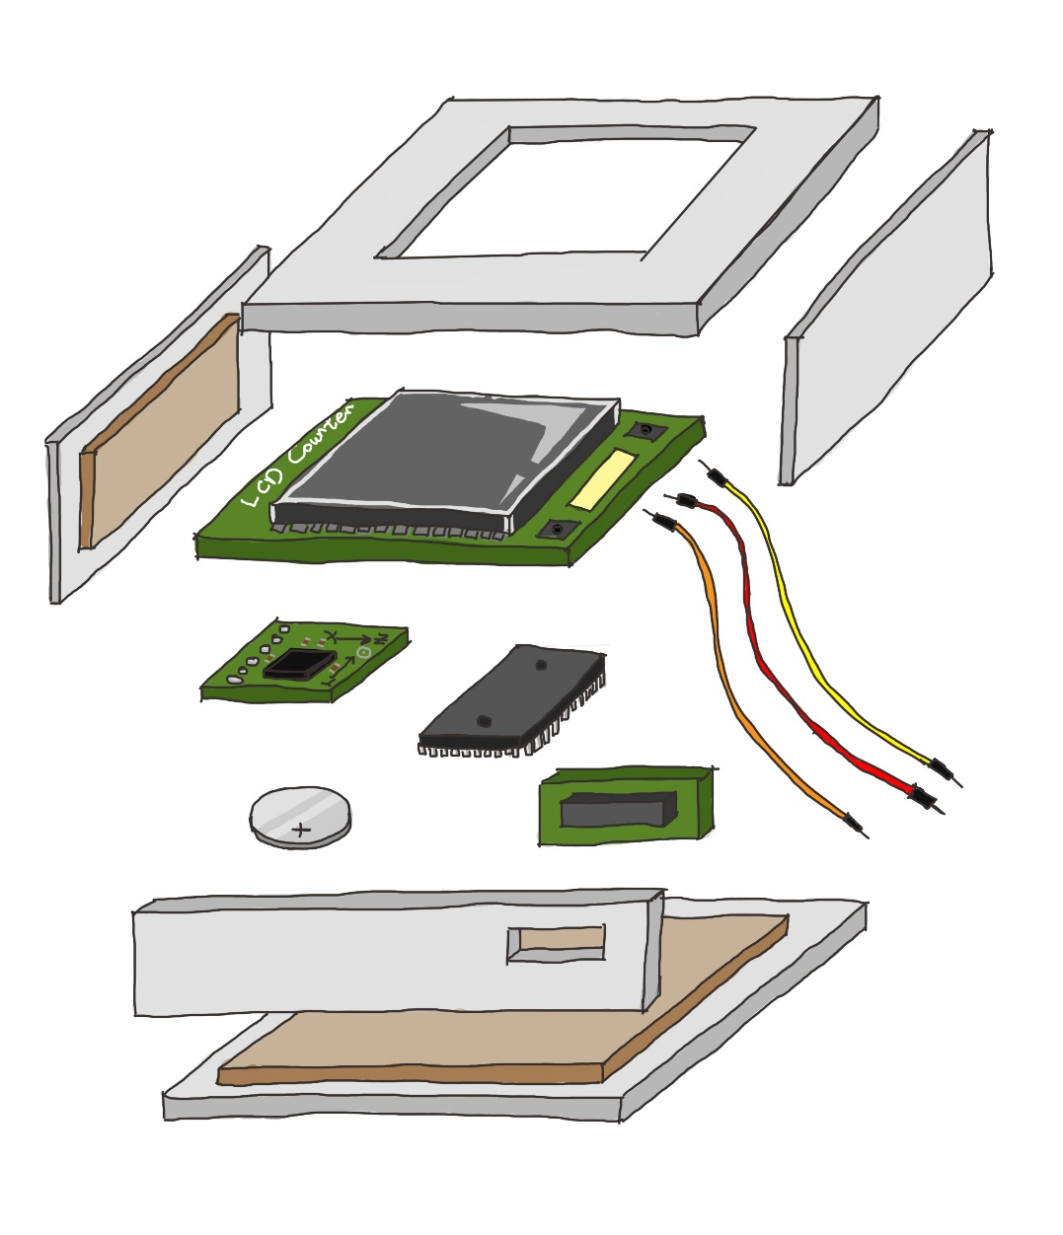
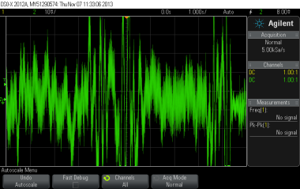
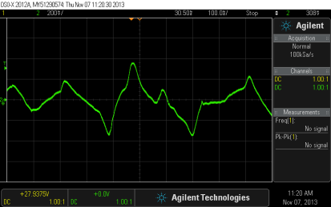
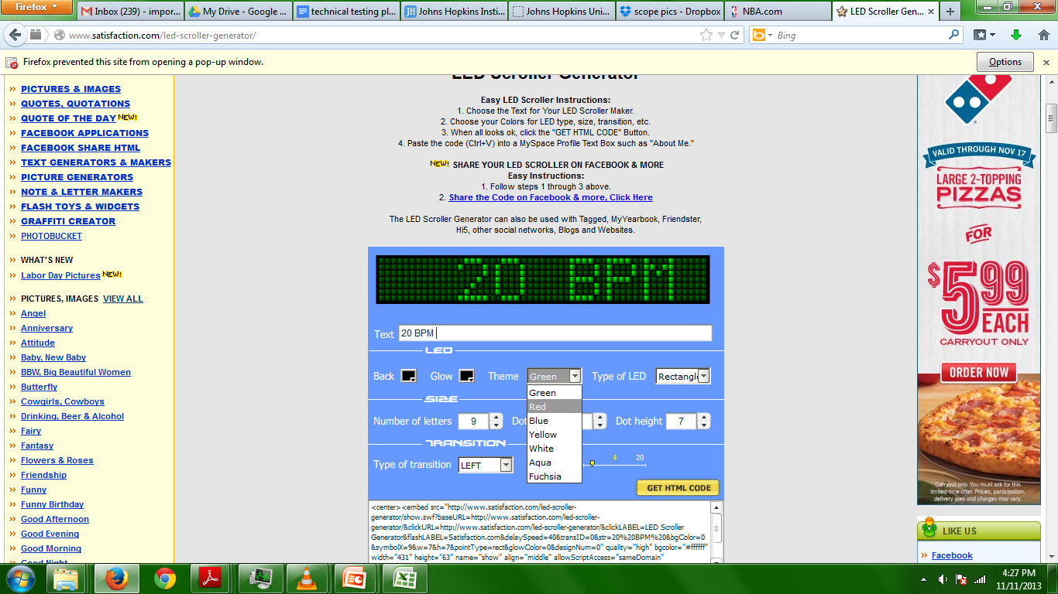
Current Prototype: What’s Inside
Problem
Need
Design
Prototype
Testing
Future
Physical input modality
Sensor
Outer casing
LCD display
Microcontroller
Filtering, processing, and amplification modalities
5V Coin Battery
Tri-axial accelerometer
Microprocessor
Power button
Base isolation/shock absorbance material
Computation of RR based on the number of exhalations detected over time
Notes:
Exploded View: Here is an exploded view of our current prototype. In the outer casing our device, we have our processing circuit board connected to the tri-axial accelerometer, the LCD screen, the microcontroller, and a battery which supplies a voltage of 5 volts. The accelerometer is the component that streams x,y,z data points into the microcontroller, which filters and processes the signal.
Block Diagram: How do our electronics works? First, our sensor, which an accelerometer, detects a physical input modality, in the form of a very noisy signal. Second, the signal then gets filtered, processed, and amplified in the processing circuit board, such that the peaks of the signal could be recognized as peaks of breaths. Third, the filtered data goes to a microprocessor, where using some computational algorithms, the data is converted to breaths per minute, which gets displayed on the LCD screen.
Back to Exploded View: Not only does it then count the breaths per minute, but it also establishes a dynamic baseline, that recalibrates itself every time a breath is taken in order to account change in the patients movements. There is also Base Isolation Shock Material that protects our device from drops.

Slide 12
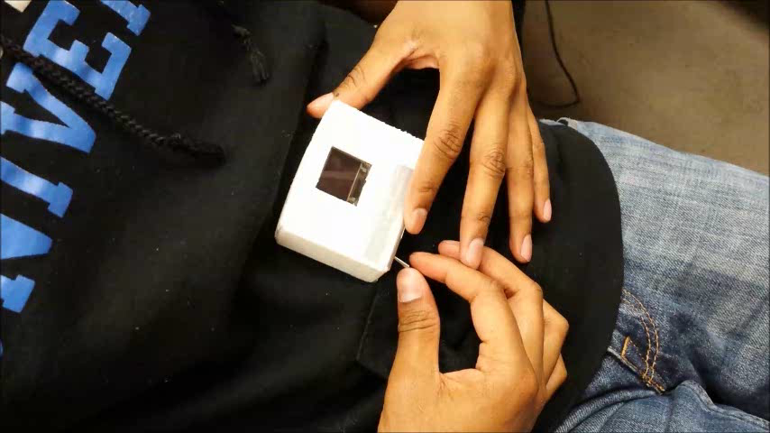
Current Prototype
Problem
Need
Design
Prototype
Testing
Future
Notes:
Describe graph,
Show real-time demonstration
X- red (parallel to stomach side to side)
Y- green (parallel to stomach up and down)
Z- blue (out from stomach)

Slide 13
Testing
Performance Testing | Does device measure RR under 15 sec & to an accuracy of ± 2 bpm ?
Problem
Need
Design
Prototype
Testing
Future
Usability Testing | Is device simple, user-friendly, & intuitive? Is it easy to teach & easy to be trained to use?
Healthy Volunteers (n = 100 people)
1. Measure RR for 15 sec
2. Have someone simultaneously measure RR with gold standard auscultation
3. Conduct Bland-Altman analysis to assess variability
Hospital Patients (n = 100 people)
1. Measure RR for 15 sec
2. Have someone simultaneously measure RR with gold standard auscultation
3. Conduct Bland-Altman analysis to assess variability
Step 1
Nurses (n=100) perform steps of triage.
As RR is measured:
a. Measure gold standard RR
b. Time the triage process & device setup
c. Compare
Step 2
Nurse Survey
IRB IN PROGRESS
Notes:
Determine how many ppl gonna test
Get more hands on – cases, lcds,
Split up roles – electronic, mechanical, irb
Performance
Goal: measures RR to accuracy of +/- 2 bpm, measures in 30 sec
1. find volunteers (n=?)
2. for design team 7 members:
a. ask them to breathe at specific intervals for a certain amount of time
- vary intervals
- while it’s happening, have someone take RR w/ auscultation for 1 min (gold standard)
- have the same person take auscultations
steps:2. have person coordinate breaths with metronome for a min
3. at the same time, have someone take RR w/ auscultation for a min
** consider change in depth of breaths, etc.**
3. for normal healthy volunteers
a. measure RR for 1 min, with gold standard
b. variability
- cluster
- bland-altman between our device & gold standard
4. for hospital patients
a. measure RR for 30 sec, with gold standard
Usability
Goal: Convenience, easy application, user-friendly, simple, intuitive; easy to teach, easy to be trained to use
- need to determine category of patients
- “functional” patients or worse?
- 2-5 patients, “critical” - lifesaving attention (triage 1)
- simulate (uncooperative, some fluids, hard to reach positions, etc)
steps:
1. normal steps of triage
2. when they take RR with our device,
- have an official do the gold standard while our device measures
- time all of triage, time how long it takes for nurse to setup
(maybe check RR at different intervals, depends)
- compare to setup time of other vitals
- nurse survey (separate irb), rate various factors on a scale of 1-5

Slide 14
Testing
Problem
Need
Design
Prototype
Testing
Future

Slide 15
Future Plans
Problem
Need
Design
Prototype
Testing
Future
Technology
Code updates: accuracy & robustness
Physical design: clip, outer casing materials, size reduction, power supply
Testing
Complete IRB
Test on healthy & hospital patients
IP
JHTT
Currently filing provisional patent

Slide 16
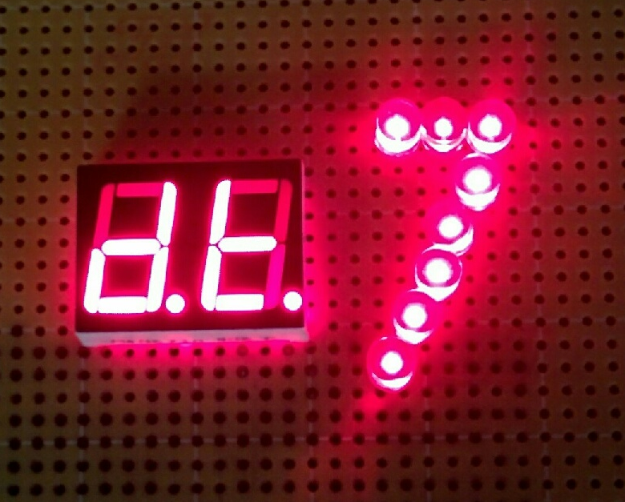
Thank You
Samuel Yang, M.D.
Edbert Hsu, M.D., M.P.H.
Robert Allen, Ph.D.
James West, Ph.D.
Barbara Maliszewski, R.N., B.S.N.
Anthony Bilenki, M.A., R.R.T.
Soumyadipta Acharya, M.D., Ph.D.
Lawrence Aronhime, M.S., M.B.A.
Ant Ozok, Ph.D.
Brock Webberman, M.S.E. Candidate
Ruben Troncoso, M.D. Candidate
Christopher Browne

Slide 17
Requested Input
Different counting algorithms?
More sensitive accelerometers recommended? Ways to overcome variable factors like baggy clothing?
Ideas for possible materials for outer casing?

Slide 18
Appendix
Clinical Problem
Current Electrical Prototype
Respiratory Sounds
Standard of Care
Current Mechanical Prototype
Gantt Chart
Existing Technology
Future Design Goals
In-Depth Clinical Problem
Goals & Constraints
Verification & Validation Testing
Problem Validation
Block Diagram
Electrical FMEA
RR Predicts Cardiac Arrest
Mechanical FMEA
Emergency Severity Index
Adhesive Testing
Prices of Triage Devices

Slide 19
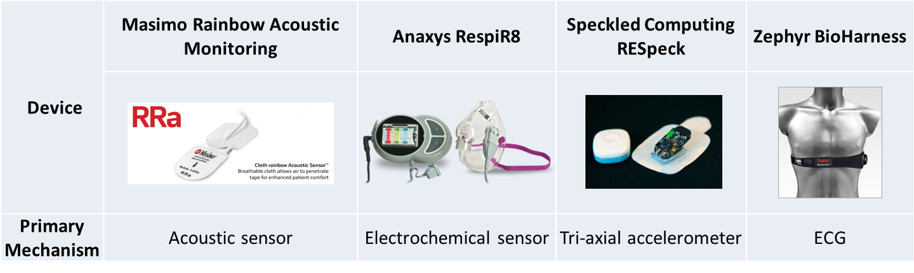
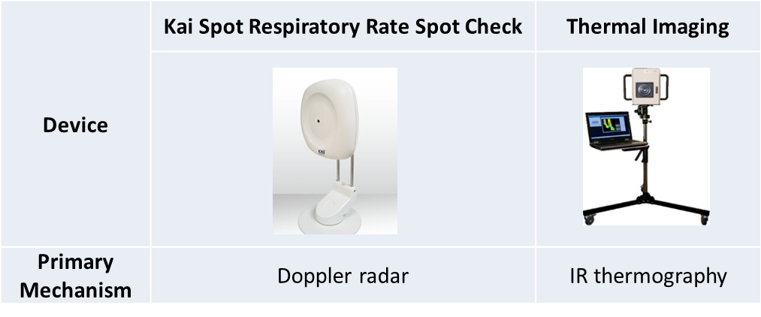
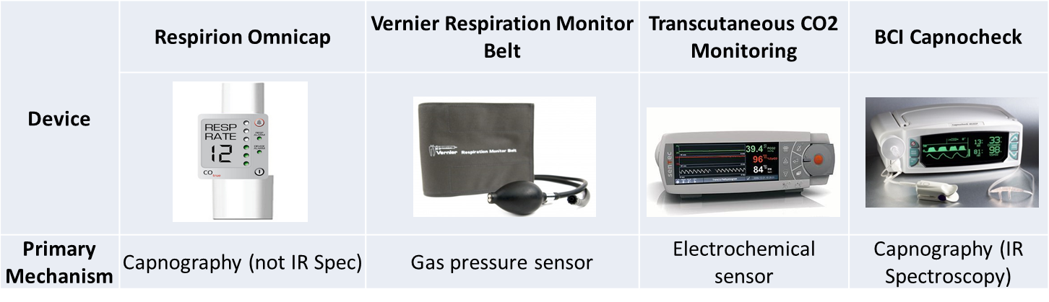
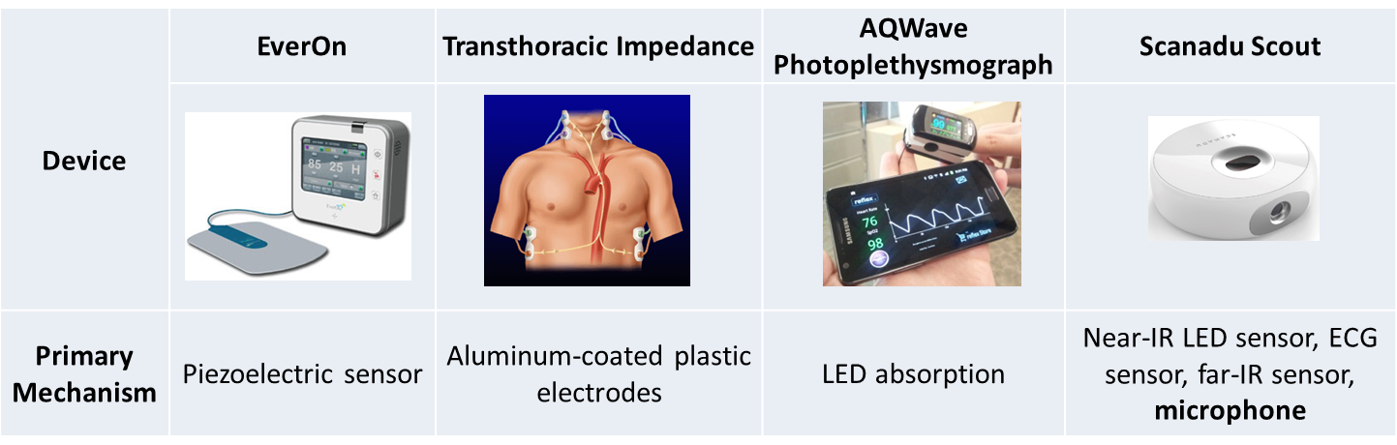
Existing Technology
Problems with Current Technology
1. Bulky and complicated to use.
2. Invasive and may be uncomfortable for an ED patient.
3. Requires long setup & measurement time; inefficient for fast-paced triage setting.
4. Too expensive.
Notes:
Here is just a handful of the existing technology out there that measures respiratory rate. Their mechanisms range from acoustic sensors to electrochemical sensors.
Most of these devices you see here were not built for emergency triage. I would like to point out the Kai Spot Respiratory Rate Spot Check, which uses a doppler radar, and was made for triage, making it our direct competitor.
However, overall, all of these devices including the Kai Spot Check, are too bulky, too expensive, too invasive, and too complicated for nurses to set up in triage. Currently, there aren’t any respiratory rate devices being used in ED triage in hospitals around the country.

Slide 20
Electrical FMEA
Component | Mode of Failure | Effects of Failure | S | O | D | RPN
Sensor | Malfunction | Incorrect reading or no reading | 1 | 2 | 2 | 4
 | Disconnect | No reading | 4 | 3 | 4 | 48
Amplifier | Malfunction | No reading/weak signal | 4 | 4 | 4 | 64
Battery | Low power/no power | No function | 4 | 2 | 4 | 32
Device | Interference | Erratic behaviour | 2 | 4 | 2 | 16
Wires | Tearing | No reading | 2 | 4 | 4 | 32
Scale
1 - Long-term patient harm
2 - Short-term patient harm
3 - Patient discomfort
4 - Return to Standard of Care
lower S = more severe | lower O = more common | lower D = less detectable

Slide 21
Mechanical FMEA
Component | Mode of Failure | Effects of Failure | S | O | D | RPN
Adhesive | Failure to stay attached | Erratic readings, no readings | 2 | 2 | 2 | 8
Casing | Material failure | Internal damage | 3 | 4 | 3 | 36
Scale
1 - Long-term patient harm
2 - Short-term patient harm
3 - Patient discomfort
4 - Return to Standard of Care
lower S = more severe | lower O = more common | lower D = less detectable

Slide 22
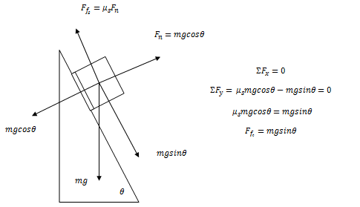

Pedifix Adhesive Testing
Trial | Total Weight | Slip?
1 | 150.2 | No
2 | 168.3 | No
3 | 208.6 | No
4 | 259.0 | No
5 | 248.7 | No
6 | 615.1 | No
7 | 1101.5 | No
8 | 1566.4 | Yes, but after 30 seconds
$$θ=58 arcdegrees$$
$$F_{f_{s}}=\left(1566.4\right)\sin\left(58\right)$$
$$F_{f_{s}}=1.3286 N$$
The moleskin has an adhesive strength that can resist 1.3286 Newtons (135.6 grams) of force.

Slide 23
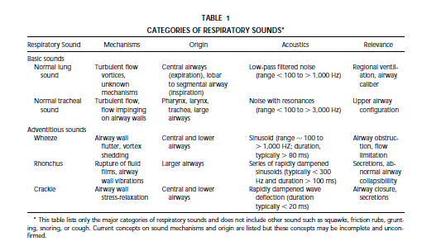

Slide 24
Prices of Triage Devices
Dynamap $2200.00- $2500.00
BP cuff $2.86
Pulse ox probe $170.00-$200.00
Pulse ox sensor $9.88

Slide 25
Design
Goals | How Our Design Addresses This
Safe to use | Electronics enclosed in a plastic casing; will use disposable adhesive interface
Measure RR accurately (± 2 bpm) | Sensor (piezoelectric or acoustic) is sensitive; circuitry and signal processing accurately filter out noise
Visual feedback | User interface displays one-time RR
Measure RR quickly (≤ 30 seconds) | Simple workflow: apply sensor, wait 15 sec, observe bpm on display
Minimize cost (≤ $50 per device) | ≤ $5 per sensor, ≤ $1 per disposable adhesive, ≤ $20 per PCB, ≤ $5 per outer casing, ≤ $20 per bluetooth (if used)
Minimize discomfort | Outer casing will be made of conformable plastic; comfortable adhesive interface - not too sticky, not too loose
Convenient | Simple workflow; simple user interface; sensor adhesive is easily applied
Easy instruction to others | Will provide instruction video in the future
Notes:
This should come after we’ve actually made a prototype & tested it

Slide 26
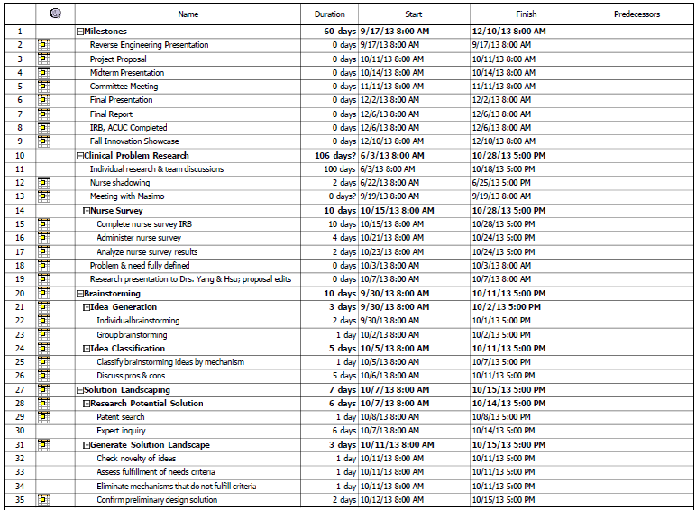
Gantt Chart through Dec. 6

Slide 27
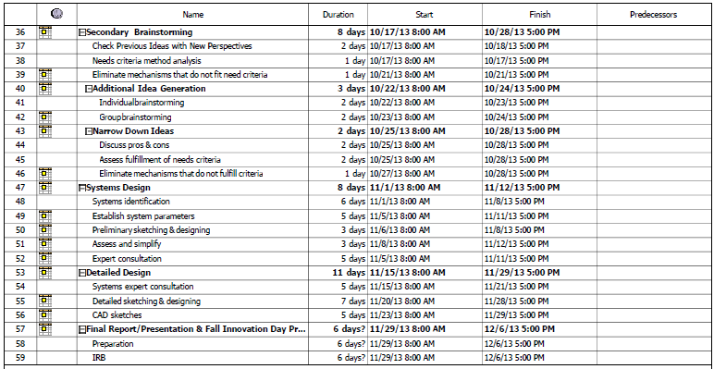
Gantt Chart through Dec. 6

Slide 28
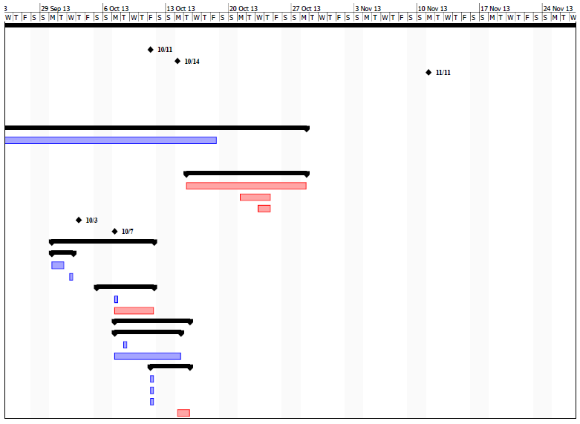
Gantt Chart through Dec. 6

Slide 29
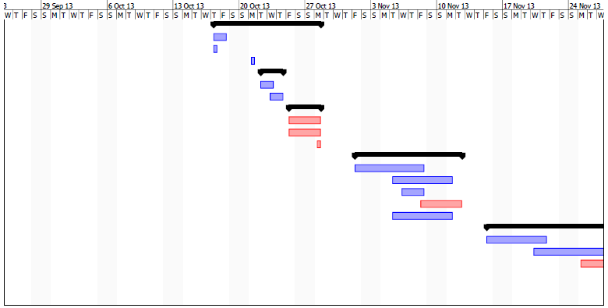
Gantt Chart through Dec. 6

Slide 30
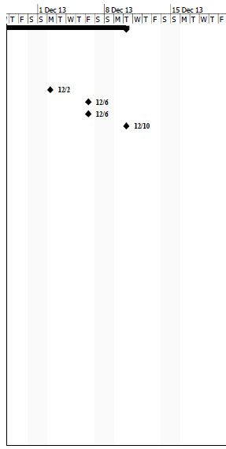
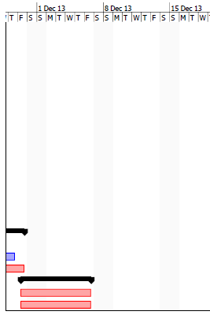
Gantt Chart through Dec. 6

Slide 31
Clinical Problem (In-Depth)
Background
The assessment of vital signs (pulse rate, oxygen saturation, respiratory rate, blood pressure, and body temperature) plays a fundamental role in medical decision-making. Vital signs objectively indicate the immediate well-being and level of physical functioning of patients, and have long been considered an imperative component of patient assessment and management.¹ Respiratory rate, in particular, plays an important role in the early recognition of diverse illnesses, such as pulmonary embolus, pneumonia, congestive cardiac failure, and toxicologic and metabolic emergencies.²
Respiratory rate has been proven to be the best predictor of cardiopulmonary arrest, even up to three days before arrest occurs.^{1, 3, 4} A prospective observational study of 1025 ED patients found that a respiratory rate greater than 20 breaths per minute was predictive of cardiopulmonary arrest within 72 hours, with an odds ratio* of 3.93, and death within 30 days, with an odds ratio of 3.56 (Figure 1).¹ Similarly, a separate evaluation of general medicine inpatients found that a respiratory rate of greater than 27 breaths per minute was predictive of cardiopulmonary arrest within 72 hours, with an odds ratio of 5.56 (Figure 2).⁴ In another prospective observational study of 1695 acute medical admissions, patients with a composite outcome of cardiopulmonary arrest, intensive care admission, or death within 24 hours had a mean respiratory rate of 27 breaths per minute, compared to controls who had a mean respiratory rate of 19 (Figure 3). While changes in pulse rate and blood pressure are comparatively small and could potentially be clinically missed, relative changes in respiratory rate are of a much greater magnitude and are therefore better at discriminating between stable patients and patients at risk of cardiopulmonary arrest.⁵
Both respiratory rate and tidal volume depend on the exchange of carbon dioxide and oxygen between the lungs and the rest of the body (Figure 4). This gas exchange relies on the body’s metabolic demands and adjusts with physical activity or in disease states such as infection. In life-threatening diseases like metabolic acidosis, the body attempts to correct hypoxemia and hypercarbia through respiratory compensation. As a result, both respiratory rate (tachypnea) and alveolar ventilation (hyperventilation) increase significantly.³ Since the magnitude of an individual’s metabolic demand is reflected in the respiratory rate, patients with an elevated respiratory rate often have a more serious illness.⁶ Conditions including hypoxemia, acidosis, sepsis, increased intracranial pressure, and hypotension are capable of inducing tachypnea, and they all also have the potential to lead to arrest.⁴ Decreased respiratory rate (bradypnea), which can result from life-threatening conditions such as renal failure, brain tumors, or high intracranial pressure, not only limits supplies of oxygen, but also endangers other organ systems in the body.⁷
In effect, respiratory rate is an important indicator of a severe abnormality in not only the respiratory system but also many other body systems, and is therefore a key predictor of adverse events.³

Slide 32
Clinical Problem (In-Depth)
Standard of Care
Respiratory rate is measured manually by nurses in ED triage, often for 15 or 30 seconds. Manual measurement can be performed either with or without contact. Contact methods include tactile observation or estimation, via the use of one’s hand or a stethoscope (auscultation) to feel for chest movement. Non-contact methods include visual monitoring of chest movement or estimation.⁸ Various long-term monitoring devices (see 2.4 Existing Technology) are often used to measure respiratory rate in other settings, like the intensive care unit (ICU) and post-surgical operations, but few devices are designed for the transient purposes of triage.

Slide 33
Clinical Problem (In-Depth)
Clinical Problem
Every year, there are approximately 129.8 million ED visits in the US.⁹ Of 209,000 yearly in-hospital cardiopulmonary arrests,¹⁰ approximately 12% occur in the ED, and 50% occur in the ICU (Figures 5, 6).^{11, 12} Although our focus is on ED triage, up to 55% of hospital patients (depending on the hospital) are admitted into an ICU within 24 hours of entry into triage.¹³ As stated earlier, respiratory rate can predict cardiopulmonary arrest up to 72 hours before it occurs; thus, with proper respiratory rate measurement, ICU in-hospital arrests can also potentially be predicted and avoided, even before admission to the ICU.
Cardiopulmonary arrest is only one of several life-threatening diseases that is seen in the ED and is indicated by respiratory rate. Unfortunately, respiratory rate is rarely measured accurately, if at all. According to a study by Lovett et. al., triage nurses’ measurements of the respiratory rates of 159 patients showed low sensitivity in detecting bradypnea and tachypnea, poor agreement with criterion standard measurements of respiratory rate (WHO recommendation of auscultation or observation for 60 seconds), as well as poor interobserver agreement. Variability of their measurements was also low (standard deviation of 3.3) compared with criterion standard measurements (standard deviation of 4.1). A lower variability indicates that their measurements are more clustered than criterion standard measurements of respiratory rate, which might suggest conscious or unconscious result selection, even though the nurses were aware that their respiratory rate measurements were being collected for this study.²
In another study with 191 patients, Bianchi et. al. found that nurse measurements of respiratory rate tended to cluster around 16 or 18 breaths per minute (Figure 7A), with 144 patients falling within this range, when in actuality there were only 39 patients who fell within this range. Similar clustering is demonstrated in Figure 8, from another study. Bianchi et. al. also found that of the 191 patients, 44 were actually tachypnic (>20 breaths per minute), but the nurses identified only 10 of the 44 as being tachypnic.¹⁴ In a study done between two careful observers, Edmonds et. al. found that independent measures of respiratory rate may differ by more than 35%, which implies that a measured respiratory rate of 16 breaths per minute may actually represent a rate anywhere between 10 (bradypnic) and 22 (tachypnic) breaths per minute.¹⁵ With more casual observers, respiratory rate measurements made in a fast-paced setting are likely to show even more variation from a carefully taken measurement, and therefore are highly unreliable.¹⁵ Finally, Philip et. al. recently discovered that nurses themselves have very low confidence in the reliability of their own respiratory rate recordings.¹⁶
The purpose of ED triage is to provide incoming patients in the ED with a brief but informative acuity rating of his or her medical state that will determine how long the patient can safely wait for medical screening and treatment.¹⁷ The most commonly used triage scoring systems, the Emergency Severity Index (ESI) and the National Early Warning Scores (NEWS), both use abnormal respiratory rate cutoffs of less than 12 and greater than 20 breaths per minute (Figures 9, 10) in defining a patient’s priority level.^{17, 18} Therefore, respiratory rate and other vitals measurements must be sufficiently accurate if these triage scoring systems are to work effectively.

Slide 34
Clinical Problem (In-Depth)
Problem Statement
Respiratory rate is one of the most sensitive markers of a patient’s condition and is often one of the first indicators of physiological deterioration, yet it is often recorded inaccurately in ED triage.
Need Statement
In order to detect the onset of certain illnesses earlier and to improve medical decision-making, there is a need to reliably measure respiratory rate in ED triage.

Slide 35
Problem Validation
“Of the four vital signs, respiratory rate, in particular, is often not recorded, even when the patient’s primary problem is a respiratory condition. This is in spite of the fact that an abnormal respiratory rate has been shown to be an important predictor of serious events such as cardiac arrest and admission to an intensive care unit (ICU).” (Cretikos et. al., 2008)
“There is often time, up to two days or more, between the first occurrence of an elevated respiratory rate and the need for CPR, during which evaluation and intervention may be taken.” (Fieselmann et. al., 1992)
“Neither triage nurses nor an electronic monitor provides accurate measurements of respiratory rate in the ED. Emergency physicians should search for new electronic modalities for measuring respiratory rate to bring respiratory rate into line with other vital signs.” (Lovett et. al., 2005)

Slide 36
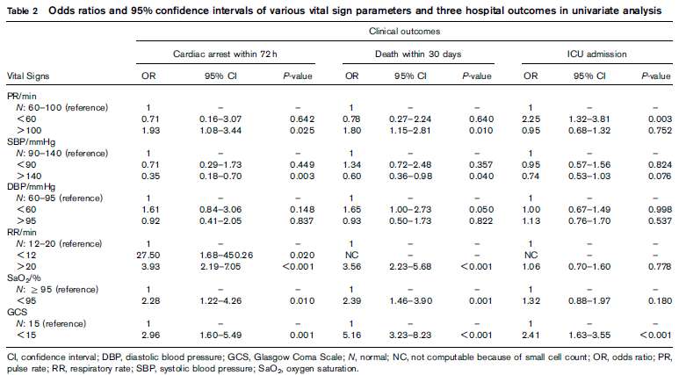
Additional Figures
Figure 1. Respiratory rate greater than 20 breaths per minute was predictive of cardiopulmonary arrest within 72 hours, with an odds ratio of 3.93, and death within 30 days, with an odds ratio of 3.56.¹

Slide 37
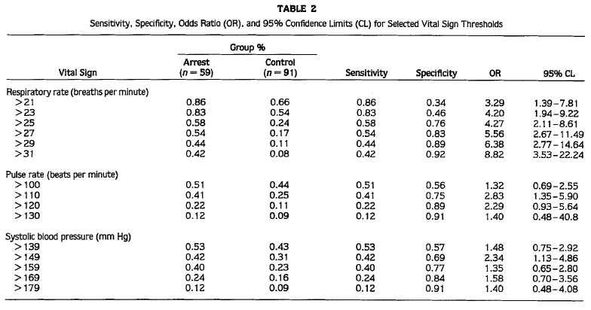
Additional Figures
Figure 2. Respiratory rate greater than 27 breaths per minute was predictive of cardiopulmonary arrest within 72 hours, with an odds ratio of 5.56, sensitivity of 0.54, and specificity of 0.83. Sensitivity represents the proportion of patients with a particular range of respiratory rate that have cardiopulmonary arrest, whereas specificity represents the proportion of patients with no particular respiratory range that do not show cardiac arrest. The greater overall relative sensitivity, specificity, and odds ratio of respiratory rate compared to that of pulse rate and blood pressure demonstrates that respiratory rate is indeed better at predicting cardiopulmonary arrest than the others. ⁴

Slide 38
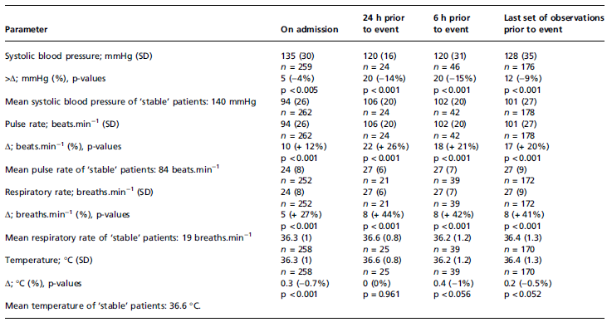
Additional Figures
Figure 3.A study of 1695 acute medical admissions. Patients with a composite outcome of cardiopulmonary arrest, intensive care admission, or death within 24 hours had a mean respiratory rate of 27 breaths per minute, compared to controls who had a mean respiratory rate of 19.⁵

Slide 39
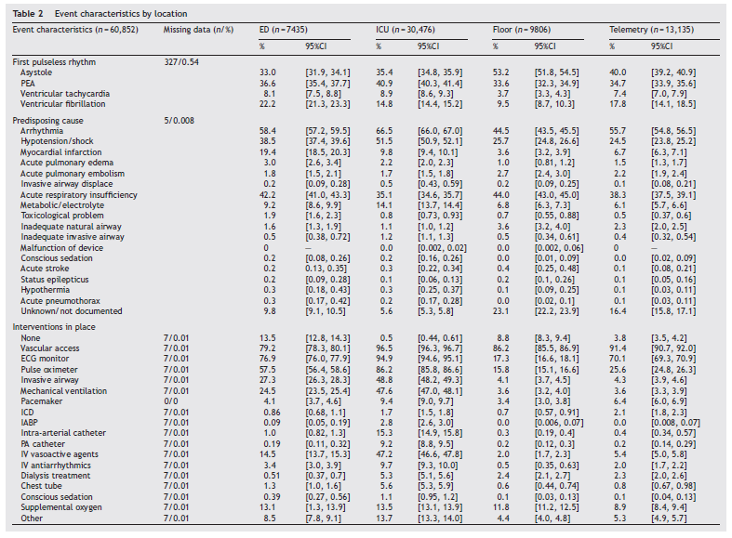
Additional Figures
Figure 5. A study of 60,852 patients with in-hospital cardiopulmonary arrest at various hospitals in National Registry of Cardiopulmonary resuscitation. Approximately 12% of in-hospital arrest occurred in the ED, while 50% occurred in the ICU.¹¹

Slide 40
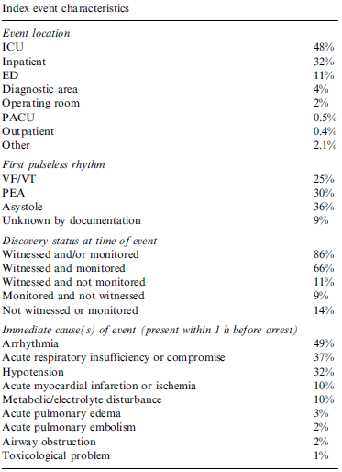
Additional Figures
Figure 6. Results from a study of 14,720 cardiopulmonary arrests that occurred in hospitals.¹²

Slide 41
Additional Figures
Figure 7. Nurse measurement of respiratory rates (A) tended to cluster around 16 or 18 breaths per minute, whereas BioHarness measurement of respiratory rates (B) seemed to have a more distributed range of respiratory rates. ¹⁴

Slide 42
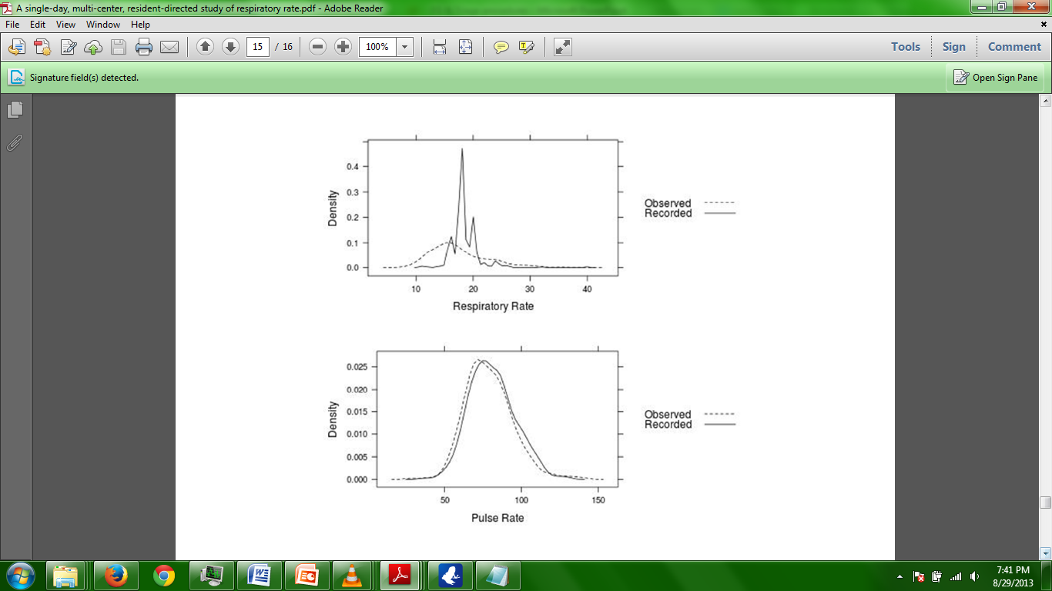
Additional Figures
Figure 8. Results of a study that demonstrate clustering of recorded respiratory rate measurements. Such clustering is hardly a problem with other vitals measurements, such as pulse rate.²²

Slide 43
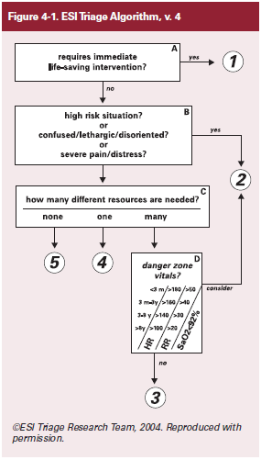
Additional Figures
Figure 9. Emergency Severity Index (ESI) Triage Algorithm. Note the role of vital signs in determining an acuity level of 2 or 3. ¹⁷

Slide 44
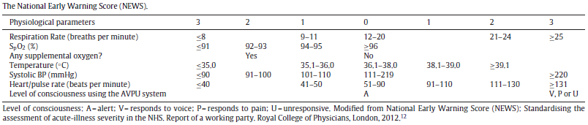
Additional Figures
Figure 10. Physiological parameters that define the National Early Warning Score (NEWS) triage prioritizing system. ¹⁸

Slide 45
References
[1] Hong, W., Earnest, A., Sultana, P., Koh, Z., Shahidah, N., & Ong, M. E. (2013). How accurate are vital signs in predicting clinical outcomes in critically ill emergency department patients. European Journal of Emergency Medicine : Official Journal of the European Society for Emergency Medicine, 20(1), 27-32.
[2] Lovett, P. B., Buchwald, J. M., Sturmann, K., & Bijur, P. (2005). The vexatious vital: Neither clinical measurements by nurses nor an electronic monitor provides accurate measurements of respiratory rate in triage. Annals of Emergency Medicine, 45(1), 68-76.
[3] Cretikos, M. A., Bellomo, R., Hillman, K., Chen, J., Finfer, S., & Flabouris, A. (2008). Respiratory rate: The neglected vital sign. The Medical Journal of Australia, 188(11), 657-659.
[4] Fieselmann, J. F., Hendryx, M. S., Helms, C. M., & Wakefield, D. S. (1993). Respiratory rate predicts cardiopulmonary arrest for internal medicine inpatients. Journal of General Internal Medicine, 8(7), 354-360.
[5] Subbe, C. P., Davies, R. G., Williams, E., Rutherford, P., & Gemmell, L. (2003). Effect of introducing the modified early warning score on clinical outcomes, cardio-pulmonary arrests and intensive care utilisation in acute medical admissions. Anaesthesia, 58(8), 797-802.
[6] Yuan, G., Drost, N. A., & McIvor, R. A. (2013). Respiratory rate and breathing pattern. McMaster University Medical Journal, 10(1), 23.
[7] McMahon, M. (2013). What is bradypnea? Retrieved 10/09/2013, from http://www.wisegeek.com/what-is-bradypnea.htm
[8] Azzarello, A. (2013, Jun 23). Personal interview.
[9] National hospital ambulatory medical care survey: 2010 emergency department summary tables (2010). Centers for Disease Control & Prevention, National Center for Health Statistics.
[10] Go, A. S., et. al. (2012). Heart Disease and Stroke Statistics - 2013 Update; A Report from the American Heart Association. Circulation. Journal of the American Heart Association., 127, 162.
[11] Kayser, R. G., Ornato, J. P., Peberdy, M. A., & American Heart Association National Registry of Cardiopulmonary Resuscitation. (2008). Cardiac arrest in the emergency department: A report from the national registry of cardiopulmonary resuscitation. Resuscitation, 78(2), 151-160.
[12] Peberdy, M. A., Kaye, W., Ornato, J. P., Larkin, G. L., Nadkarni, V., Mancini, M. E., et al. (2003). Cardiopulmonary resuscitation of adults in the hospital: A report of 14720 cardiac arrests from the national registry of cardiopulmonary resuscitation. Resuscitation, 58(3), 297-308.
[13] Seymour, C. W., Iwashyna, T. J., Ehlenbach, W. J., Wunsch, H., & Cooke, C. R. (2012). Hospital-level variation in the use of intensive care. Health Services Research, 47(5), 2060-2080.
[14] Bianchi, W., Dugas, A. F., Hsieh, Y. H., Saheed, M., Hill, P., Lindauer, C., et al. (2013). Revitalizing a vital sign: Improving detection of tachypnea at primary triage. Annals of Emergency Medicine, 61(1), 37-43.
[15] Edmonds, Z. V., Mower, W. R., Lovato, L. M., & Lomeli, R. (2002). The reliability of vital sign measurements. Annals of Emergency Medicine, 39(3), 233-237.
[16] Philip, K., Richardson, R., & Cohen, M. (2013). Staff perceptions of respiratory rate measurement in a general hospital. British Journal of Nursing (Mark Allen Publishing), 22(10), 570-574.
[17] Gilboy, N., Tanabe, T., Travers, D., & Rosenau, A. M. (November 2011). Emergency severity index: A triage tool for emergency department care, version 4. implementation handbook 2012 edition. (AHRQ Publication No. 12-0014 ed.). Rockville, MD.: Agency for Healthcare Research and Quality.
[18] Smith, G. B., Prytherch, D. R., Meredith, P., Schmidt, P. E., & Featherstone, P. I. (2013). The ability of the national early warning score (NEWS) to discriminate patients at risk of early cardiac arrest, unanticipated intensive care unit admission, and death. Resuscitation, 84(4), 465-470.
[19] Privitera, M. B. (2011). What is ease of use? Industrial Designers Society of America.
[20] Title page image: Trauma Care. Retrieved October 7, 2013 from http://www.swhealthcaresystem.com/hospital-services/trauma-care.
[21] The Respiratory System. Retrieved October 8, 2013 from http://www.nhlbi.nih.gov/health/health-topics/topics/hlw/system.html.
[22] Folke, M., Cernerud, L., Ekstrom, M., & Hok, B. (2003). Critical review of non-invasive respiratory monitoring in medical care. Medical & Biological Engineering & Computing, 41(4), 377-383.
[23]Semler, M. W., Stover, D. G., Copland, A. P., Hong, G., Johnson, M. J., Kriss, M. S., et al. (2013). Flash mob research: A single-day, multicenter, resident-directed study of respiratory rate. Chest, 143(6), 1740-1744.
[24] Brown, R. H. (March 2008, The piezo solution for vital signs monitoring. Medical Design Technology, 36-40.
[25] Duffin, J. The neural control of respiration. Toronto, Canada: University of Toronto.
[26] Hok, B., Wiklund, L., & Henneberg, S. (1993). A new respiratory rate monitor: Development and initial clinical experience. International Journal of Clinical Monitoring and Computing, 10(2), 101-107.
[27] Marks, M. K., South, M., & Carter, B. G. (1995). Measurement of respiratory rate and timing using a nasal thermocouple. Journal of Clinical Monitoring, 11(3), 159-164.

